Slide 1
M A L E R E I
Usability Testing and Verification
February – March 2020
Neeraj Anturkar
Priya Kumari
11012398
11012499

Slide 2
C O N T E N T S
I N T R O D U C T I O N
M O T I V A T I O N
C O M P E T I T O R A N A L Y S I S
D E S I G N P R O C E S S
D E M O
U S A B I L I T Y T E S T I N G
T E S T A N A L Y S I S
C O N C L U S I O N

Slide 3
I N T R O D U C T I O N
A platform for local artists, to present and sell their art online

Slide 4
M O T I V A T I O N
Missing platform where local artist can bid for their art

Slide 5
TECHNOLOGIES
USED

Slide 6
TECHNOLOGIES
USED
TECHNOLOGY | PURPOSE
AdobeXD | Design
MEAN | Implementation
Karma-Jasmine | Automation Testing
GitHub | Software Version Control

Slide 7
C O M P E T I T O R A N L Y S I S

Slide 8
ArtFinder
E- Commerce
Ships worldwide
Artist story
No Biding support
No Events Organized

Slide 9
ArtSpace
Browse by Price
Sells Objects and Books too
No Biding support
No Events Organized

Slide 10
D E S I G N P R O C E S S

Slide 11
USER FLOW

Slide 12


USER FLOW
VIEW PAINTINGS
PLACE A
BID
CREATE A LISTING
USER
VIEW
EVENTS
LOGIN
REGISTER
CREATE
EVENTS
ADMIN

Slide 13
PAPER PROTOTYPE

Slide 14
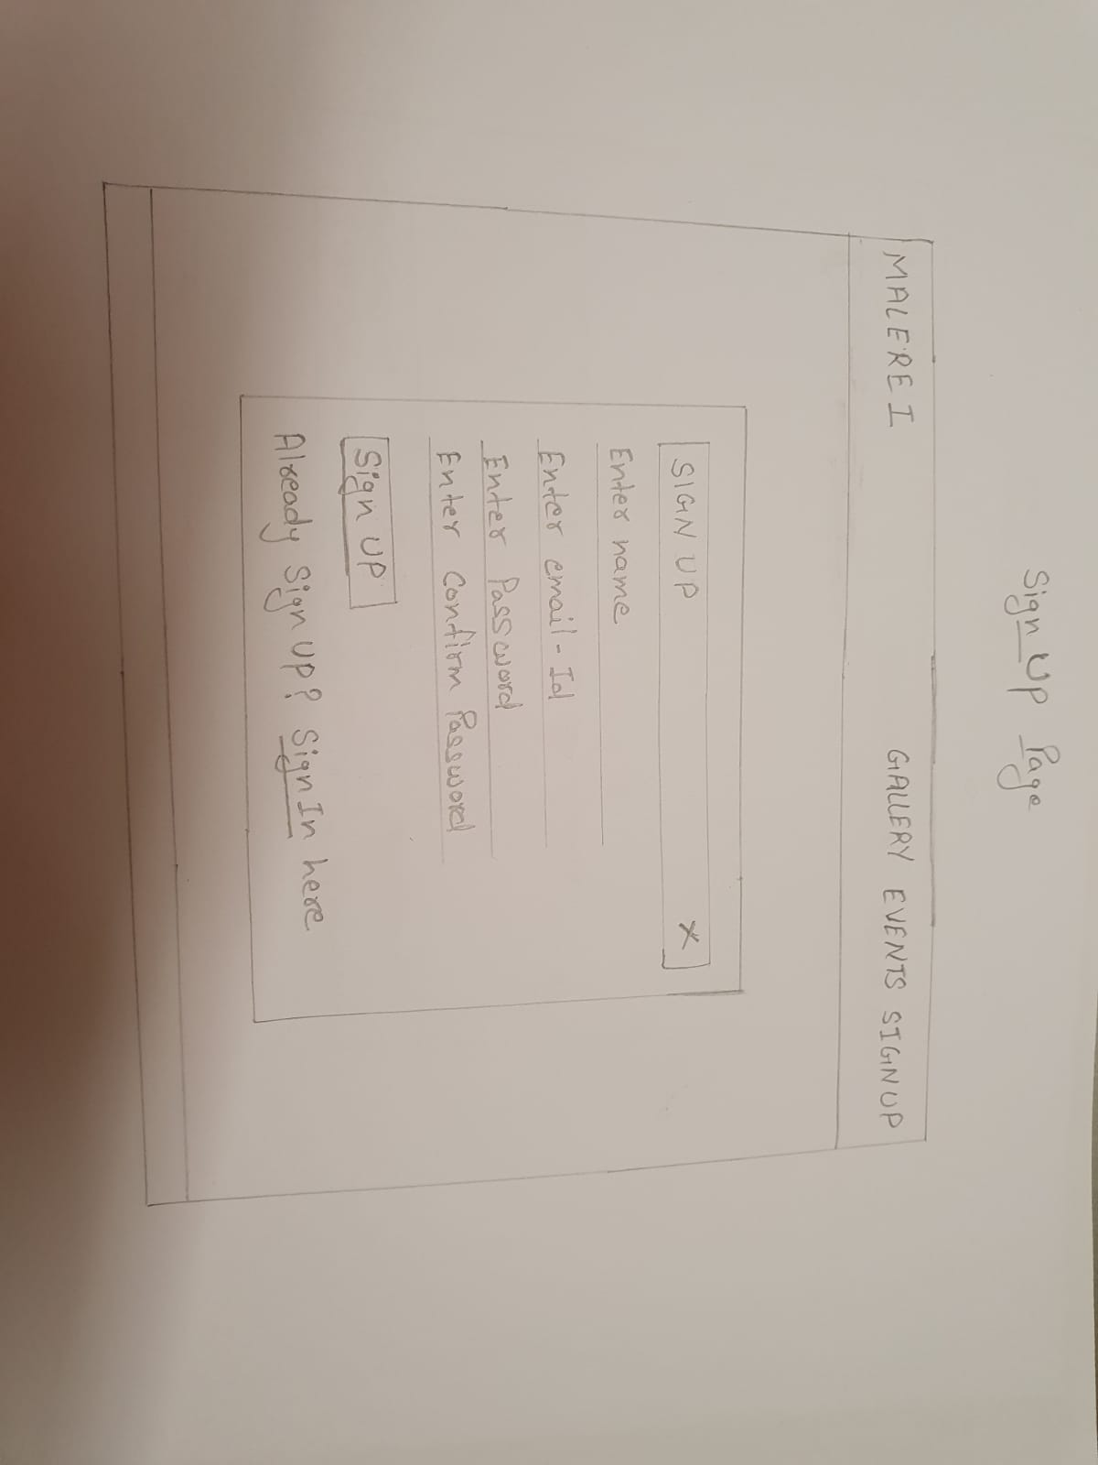
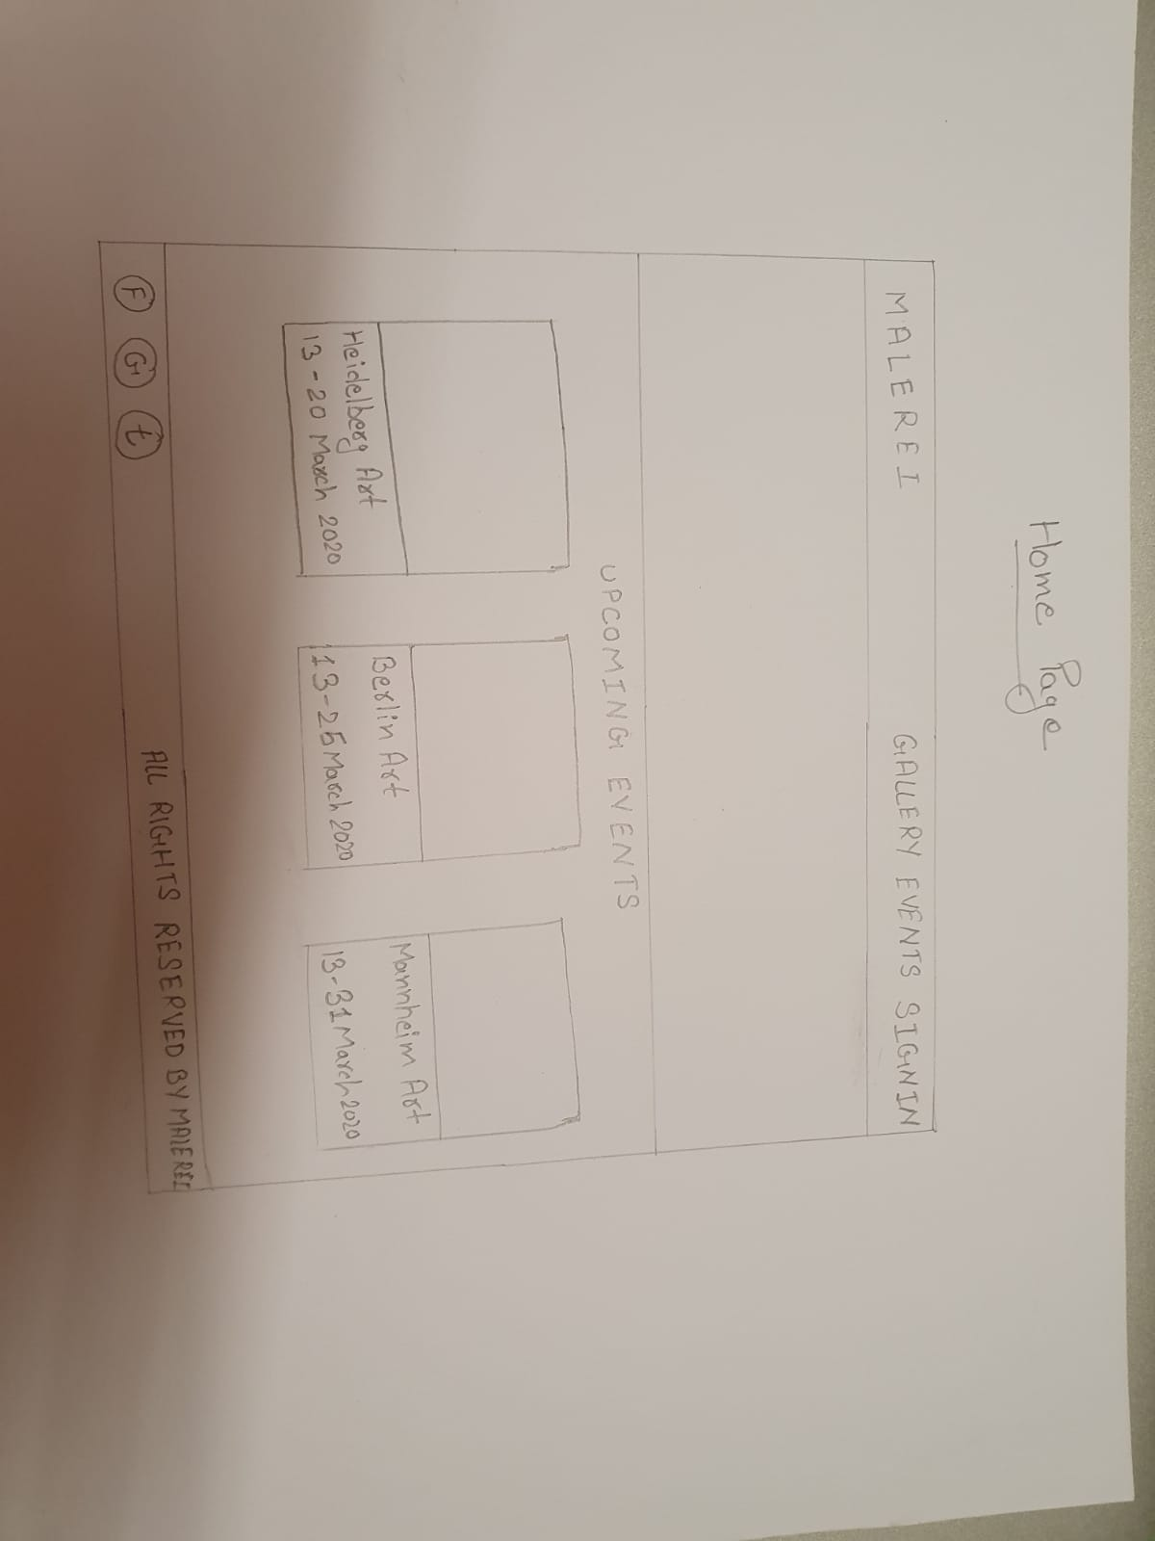
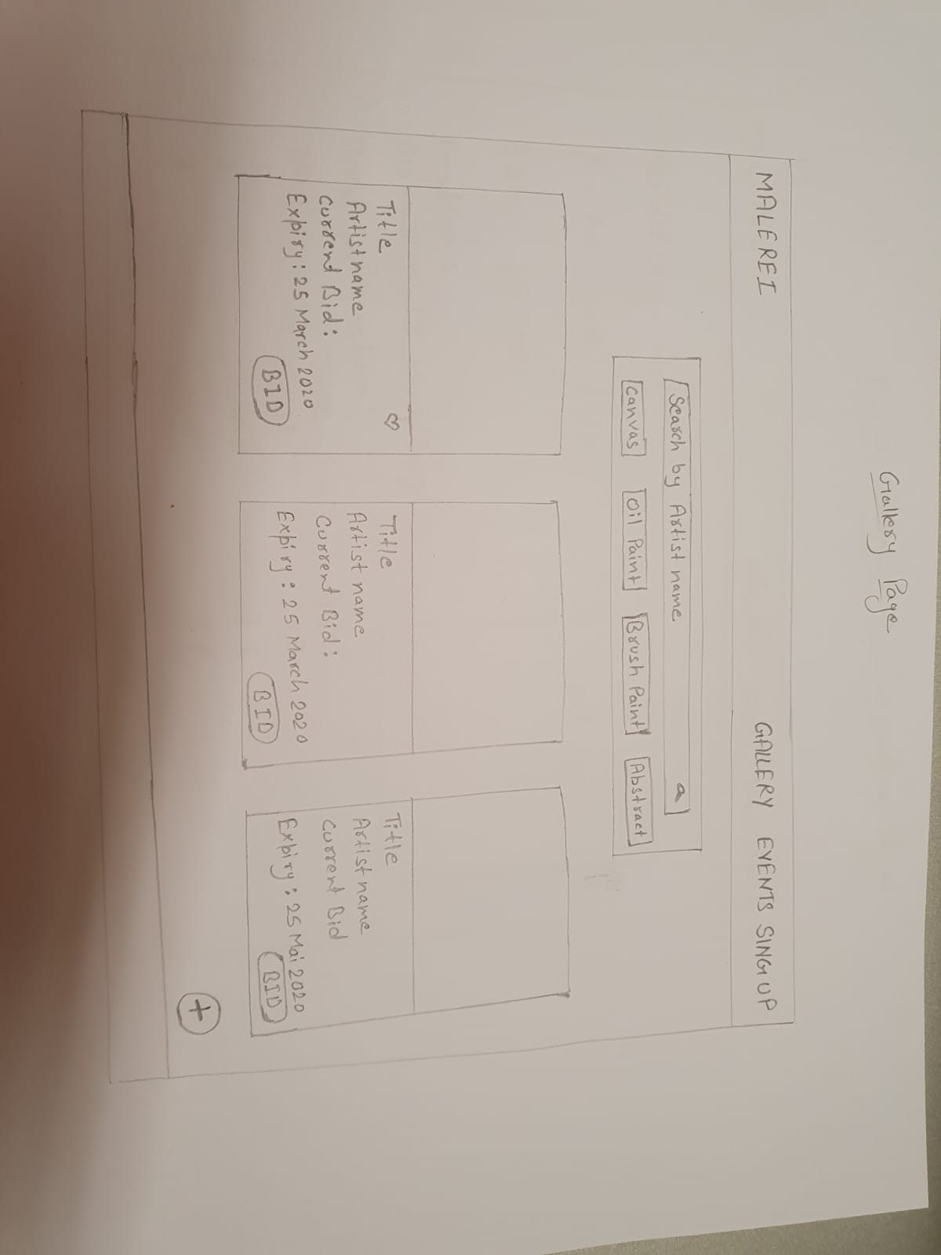
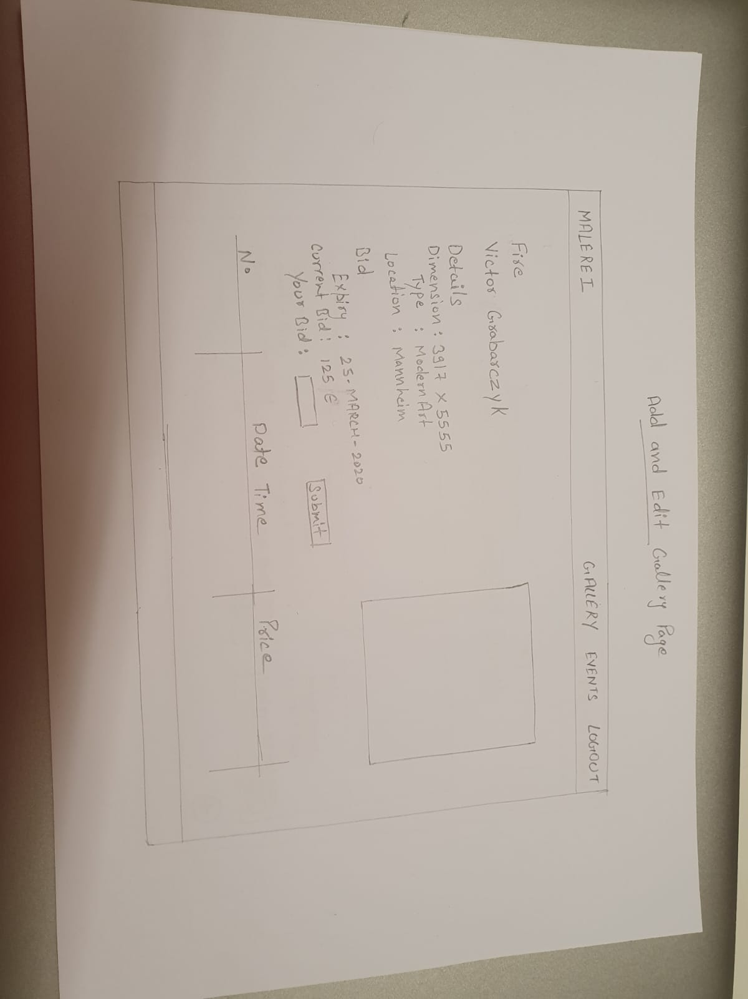
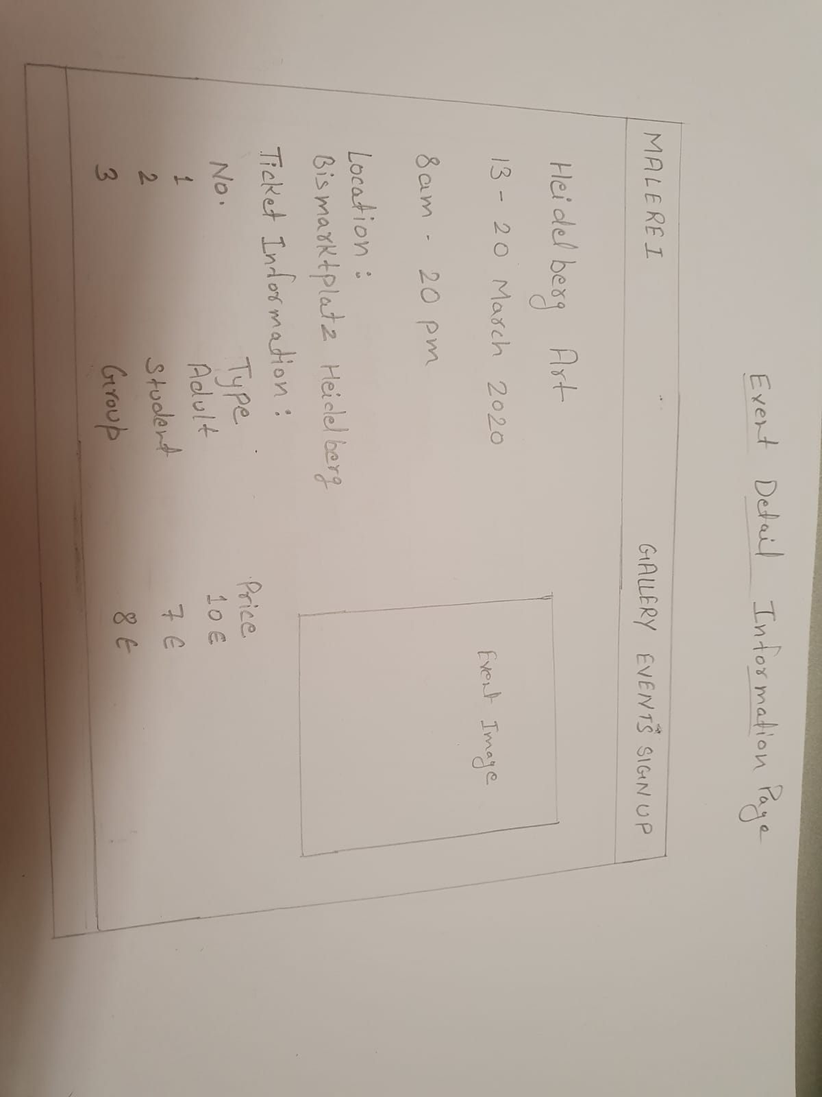

Slide 15
WIREFRAMES

Slide 16
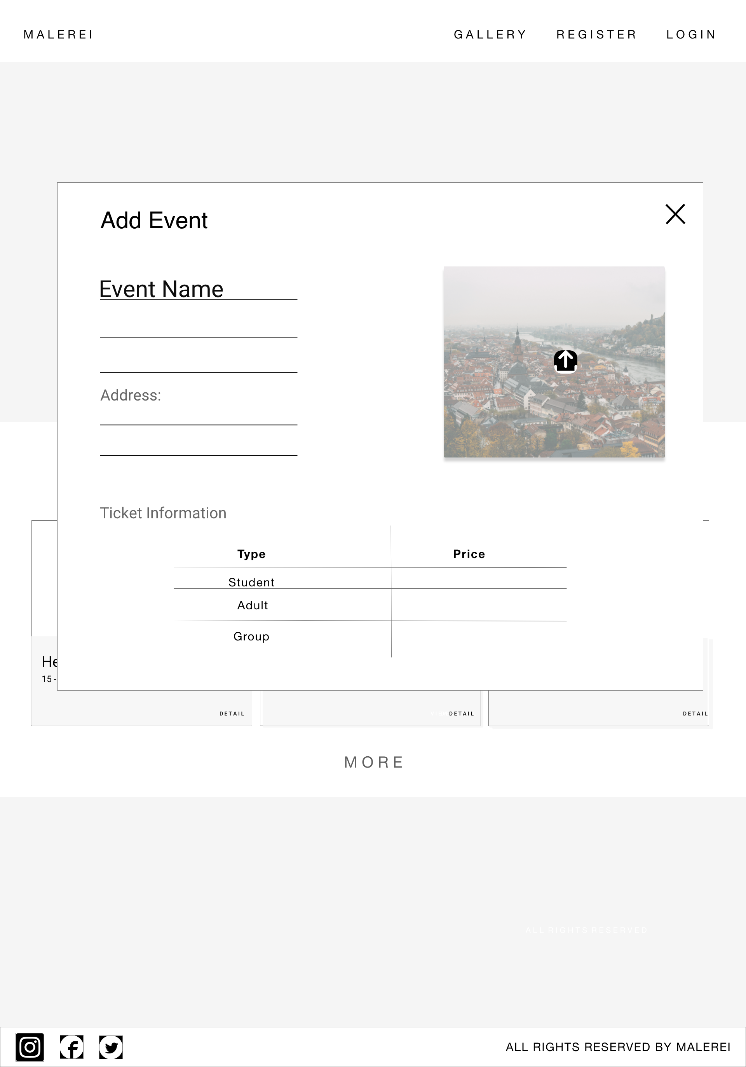
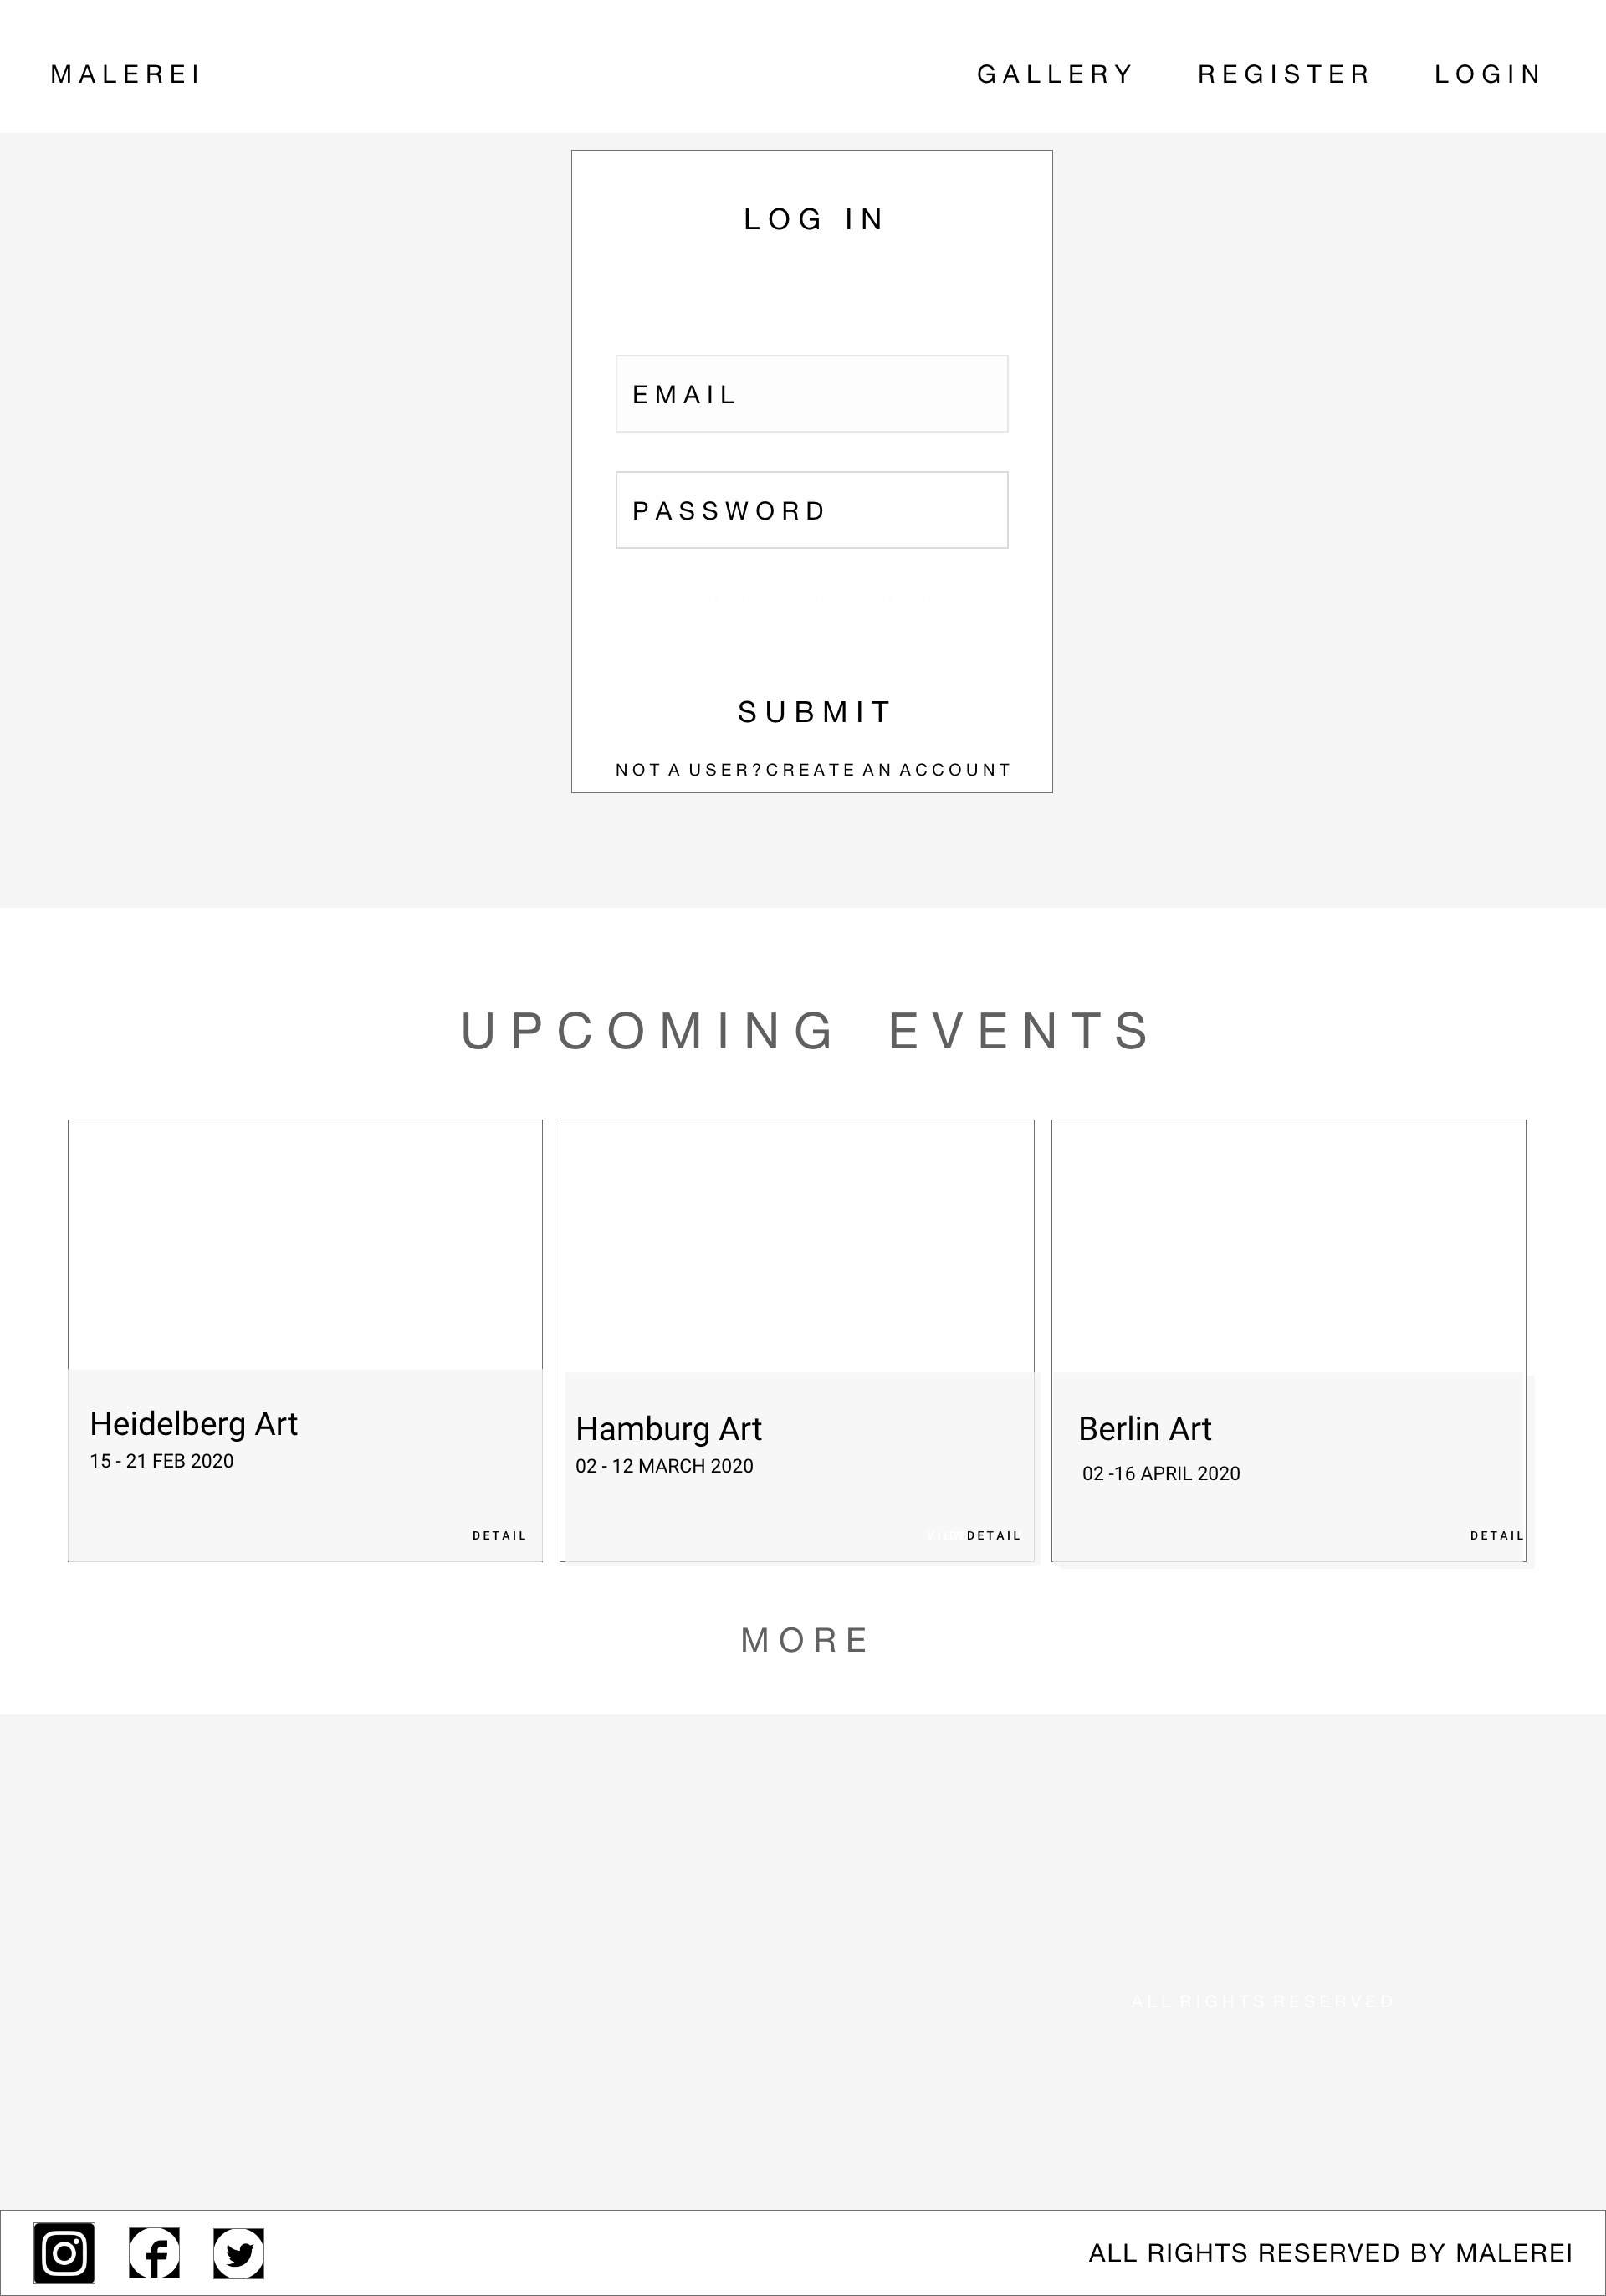
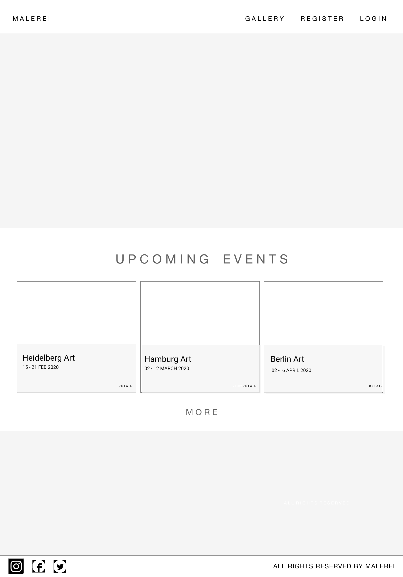
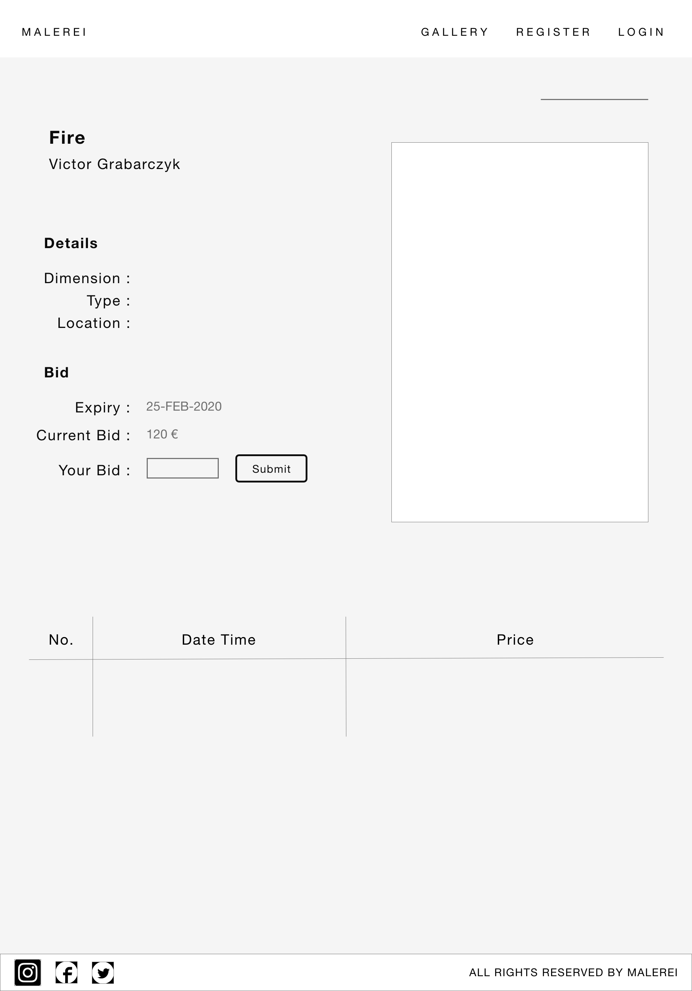
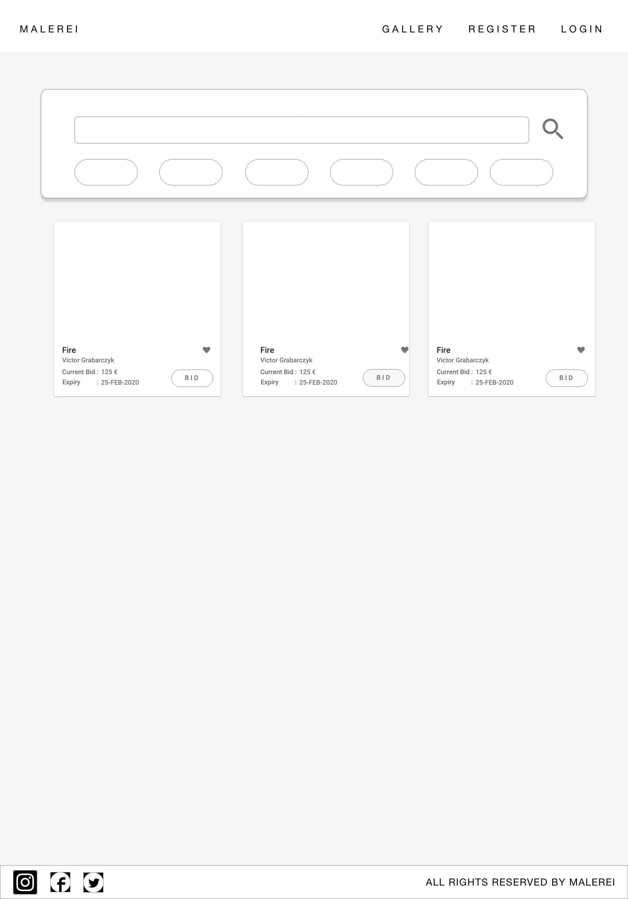

Slide 17
MOCKUP

Slide 18

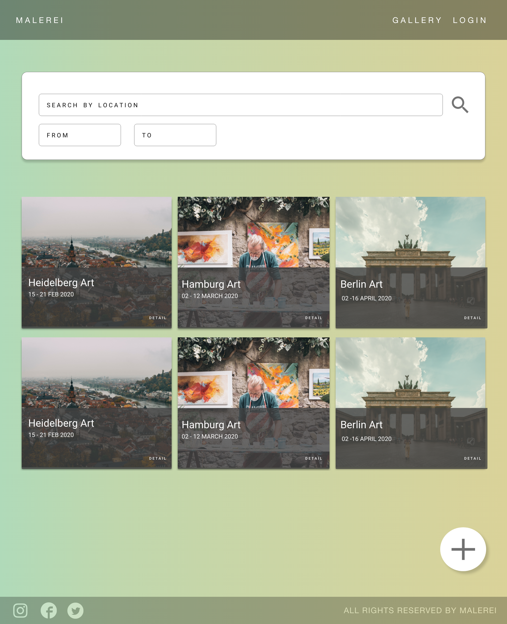
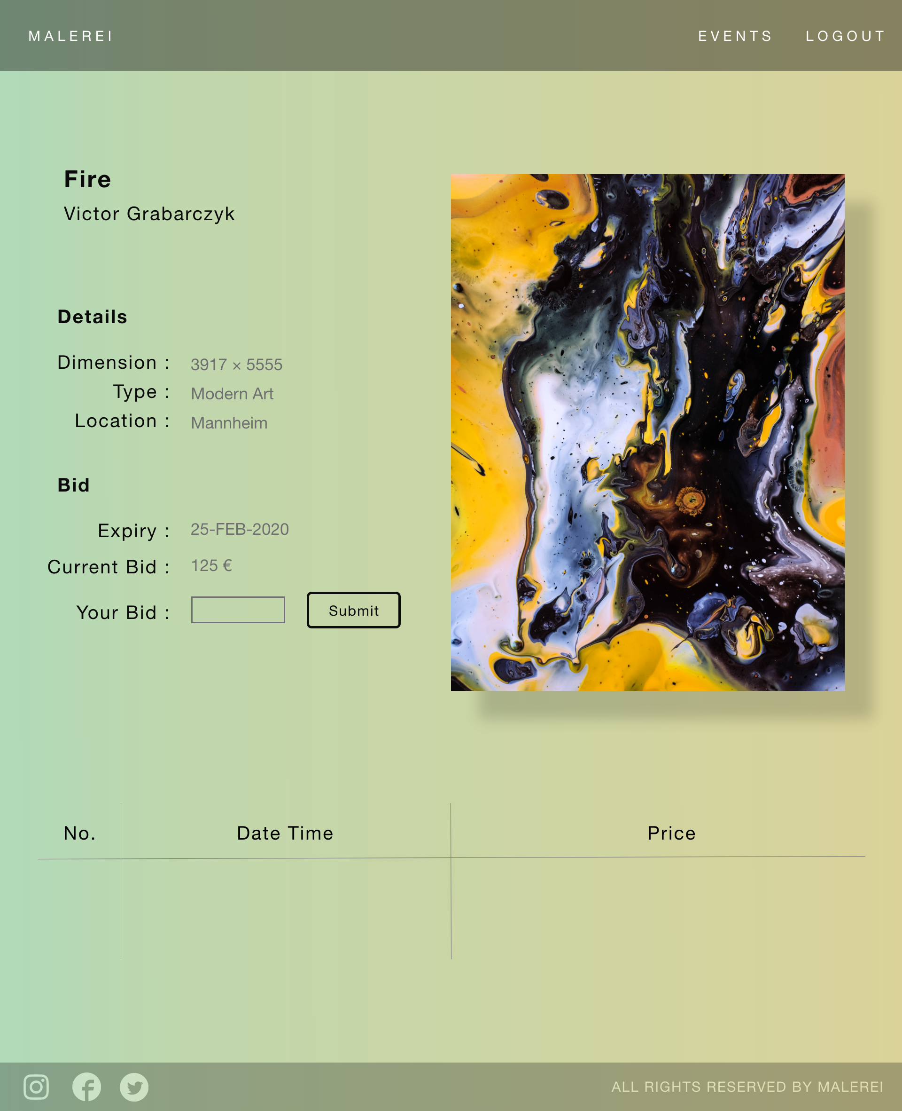
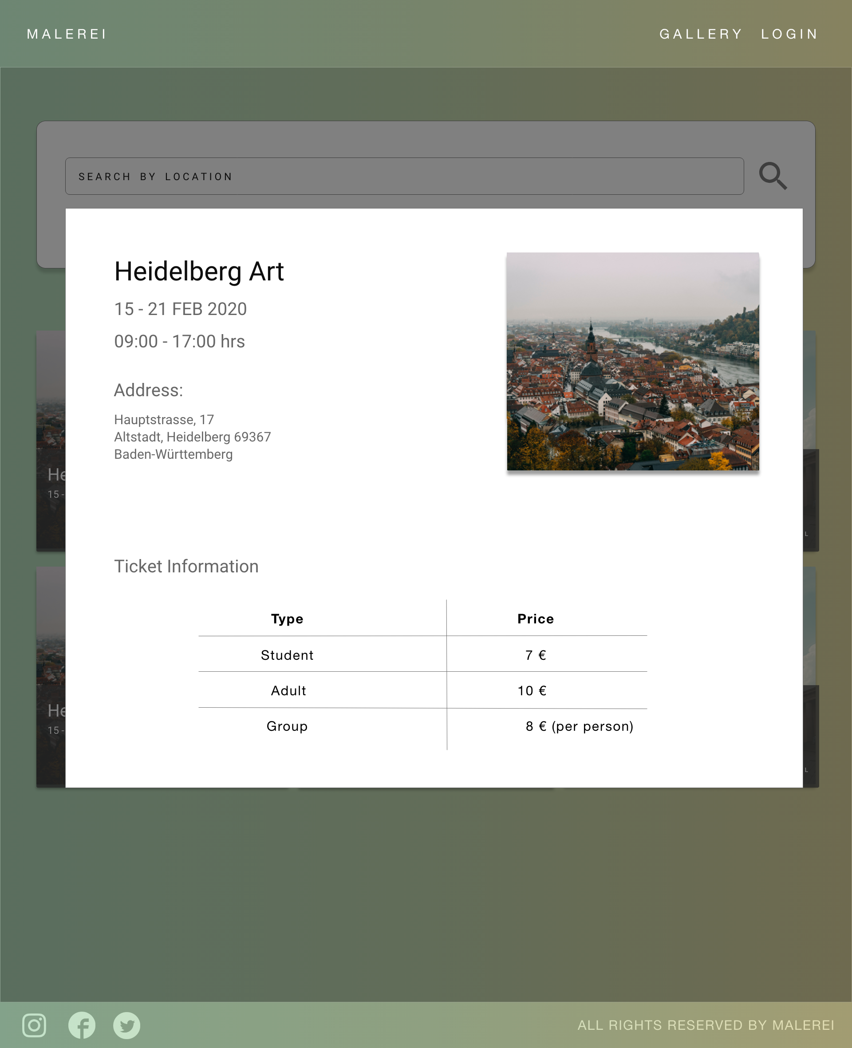
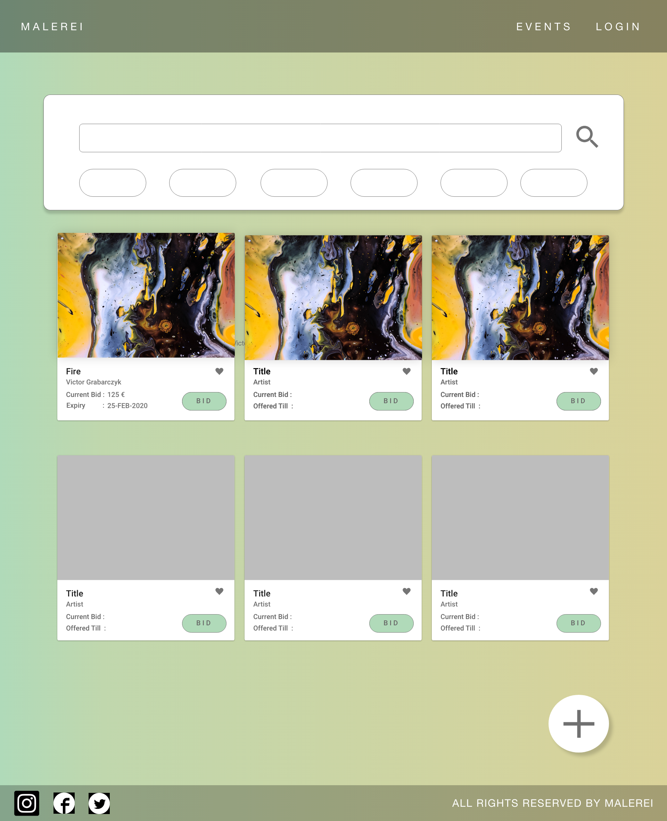

Slide 19
D E M O

Slide 20
U S A B I L I T Y T E S T I N G

Slide 21
S U R V E Y

Slide 22
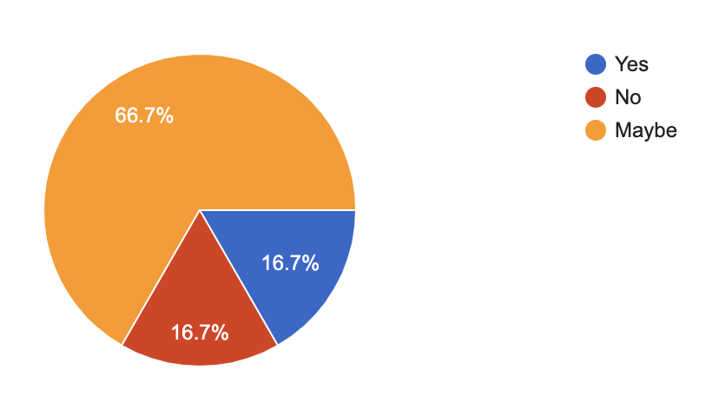
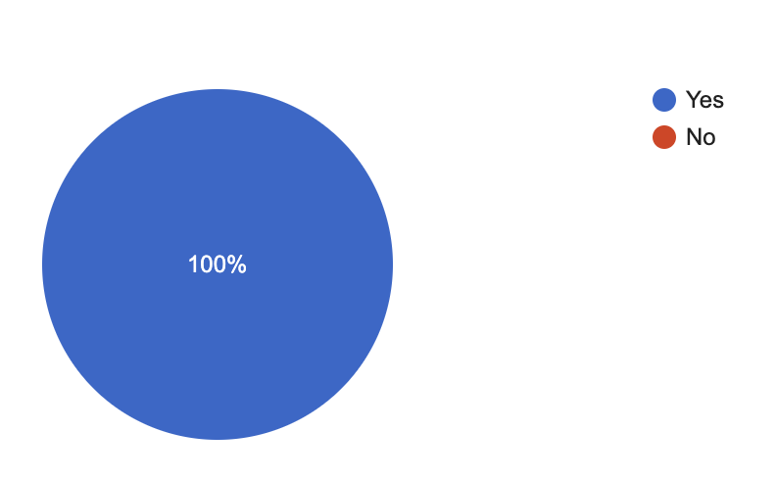
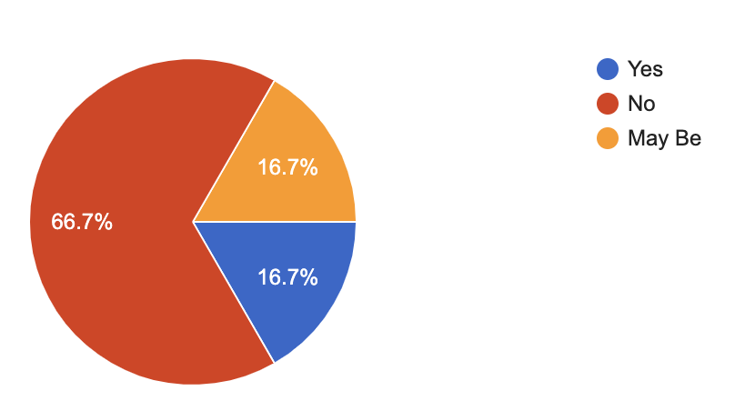
S U R V E Y
People willing to buy and bid for paintings online
People interested in getting information
of local art events
People willing to sell paintings online

Slide 23
RED ROUTES

Slide 24
RED ROUTES
All times | Add Event | Register | Add Painting | View Gallery
Most times |  |  | Login | View Events
Sometimes |  |  |  | Place a Bid
Few times
 | Few Users | Some Users | Most Users | All users

Slide 25
TEST PLAN

Slide 26
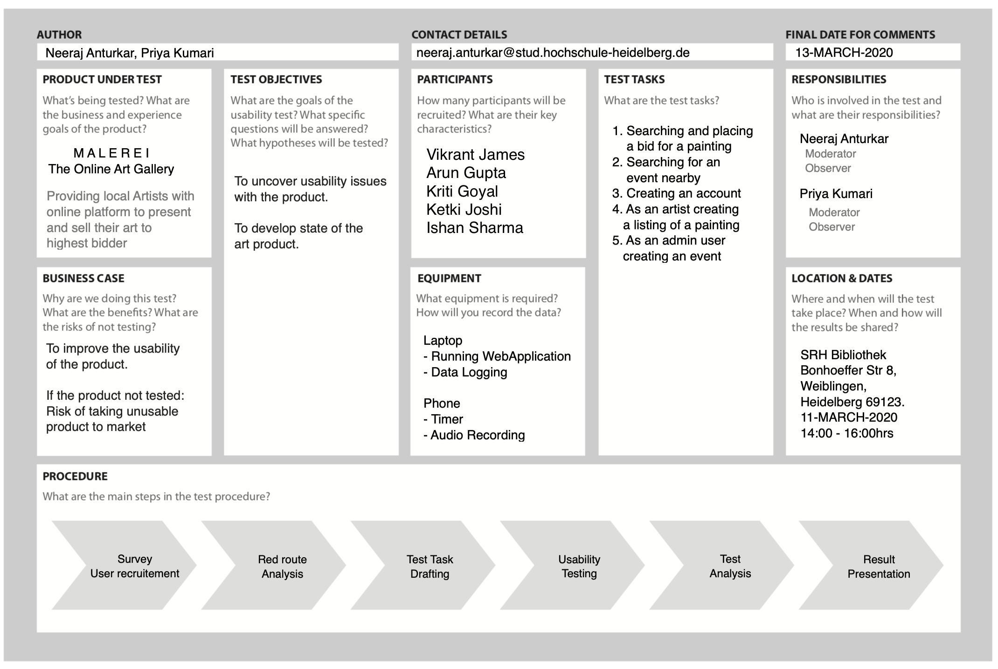
TEST PLAN

Slide 27
TEST TASKS

Slide 28

TEST TASKS
Create an Account
Search and Bid for a Painting
Search for an Event
Create Painting Listing
Create an Event

Slide 29


TEST TASKS
Create an Account
As an Art enthusiast, you would like to create an account on M A L E R E I , So that you can view paintings by local artists.
Search and Bid for a Painting
Search for an Event
Create Painting Listing
Create an Event

Slide 30
TEST TASKS
Search and Bid for a Painting
Create an Account
As an Art enthusiast, you would like to acquire a painting listed on M A L E R E I. Search for a painting in Mannheim and place a bid for the same.
Search for an Event
Create Painting Listing
Create an Event

Slide 31
TEST TASKS
Search for an Event
Create an Account
As an Art enthusiast, you would like to know about upcoming art events hosted by M A L E R E I. Look for an upcoming event, and get details about the event such as address and timings
Search and Bid for a Painting
Create Painting Listing
Create an Event

Slide 32
TEST TASKS
Create Painting Listing
Create an Account
As an Artist, you want to add your painting for sale on M A L E R E I. Create a painting listing with details of the paintings like dimension, type, location, starting price etc.
Search and Bid for a Painting
Search for an Event
Create an Event

Slide 33
TEST TASKS
Create an Event
Create an Account
As an Admin user of M A L E R E I, you want to organize an event so that artist and art enthusiast come together. Create an event, by giving details of the event like name, address, duration and timings.
Search and Bid for a Painting
Search for an Event
Create Painting Listing

Slide 34

TEST TASKS
Create an Account
Search and Bid for a Painting
Search for an Event
Create Painting Listing
Create an Event

Slide 35
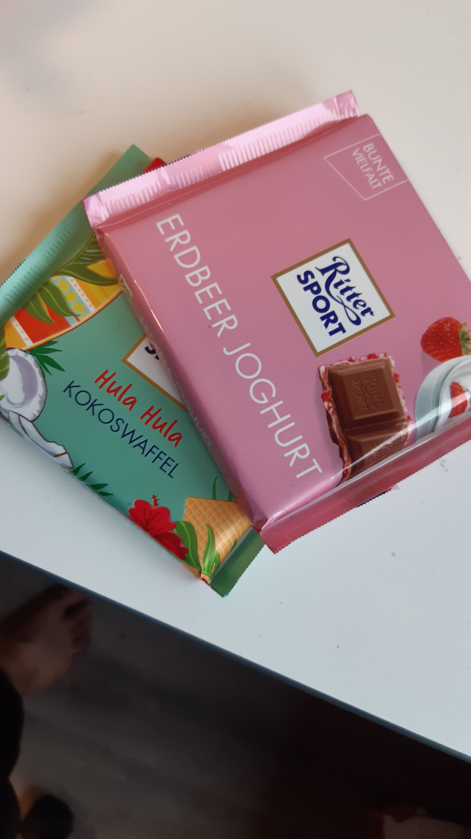

TEST EXECUTION

Slide 36
A U T O M A T I O N T E S T I N G

Slide 37
T E S T A N A L Y S I S

Slide 38
EFFECTIVENESS
Participant | Task 1 (register) | Task 2 (search event) | Task 3 (create painting) | Task 4 (create event) | Task 5 (place bid)
1 | 100% | 100% | 100% | 100% | 100%
2 | 100% | 100% | 100% | 100% | 100%
3 | 100% | 100% | 100% | 100% | 100%
4 | 100% | 100% | 100% | 100% | 100%
5 | 100% | 100% | 100% | 100% | 100%

Slide 39
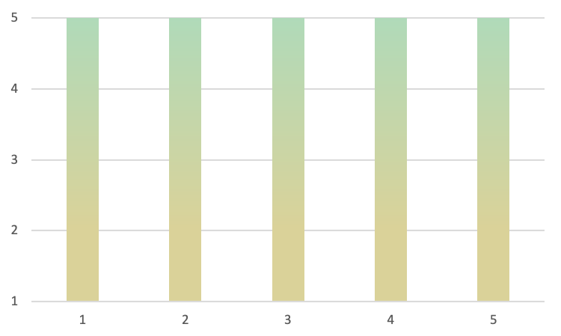
EFFECTIVENESS
Effectiveness Probability
Low | High | Best
60% | 100% | 86%
Participant | Task 1 (register) | Task 2 (search event) | Task 3 (create painting) | Task 4 (create event) | Task 5 (place bid)
1 | 100% | 100% | 100% | 100% | 100%
2 | 100% | 100% | 100% | 100% | 100%
3 | 100% | 100% | 100% | 100% | 100%
4 | 100% | 100% | 100% | 100% | 100%
5 | 100% | 100% | 100% | 100% | 100%
Users
Tasks
Calculations with 95% Confidence
Notes:
All users could complete all tasks
Binomial confidence interval test
The 95% confidence interval defines a range of values that you can be 95% certain contains the population mean.

Slide 40
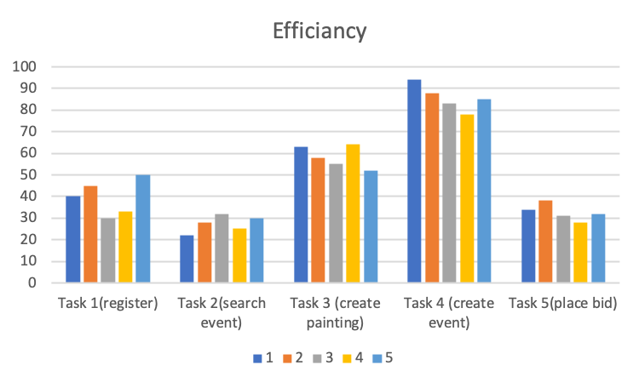
EFFICIENCY
Time in seconds
Users

Slide 41
EFFICIENCY
 | Task 1(register) | Task 2(search event) | Task 3 (create painting) | Task 4 (create event) | Task 5(place bid)
AVG | 39.600 | 27.400 | 58.400 | 85.600 | 32.600
SD | 8.264 | 3.975 | 5.128 | 5.941 | 3.715
Time in seconds
Tasks | RT(-) | RT(+)
Task 1 (register) | 23.40 | 55.80
Task 2 (search event) | 19.61 | 35.19
Task 3 (create painting) | 48.35 | 68.45
Task 4 (create event) | 73.95 | 97.25
Task 5 (place bid) | 25.32 | 39.88
Users
Notes:
Real time = avg time +- 1.96 * stand dev
The 95% confidence interval defines a range of values that you can be 95% certain contains the population mean.

Slide 42
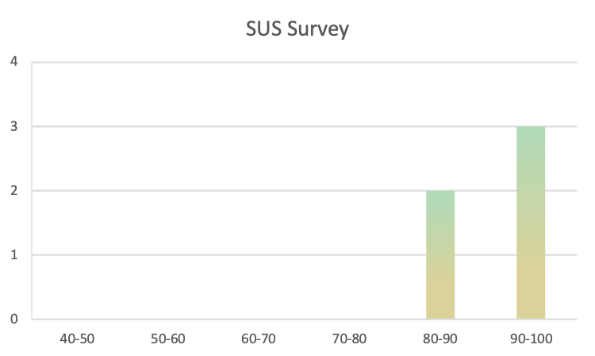
SATISFACTION

Slide 43
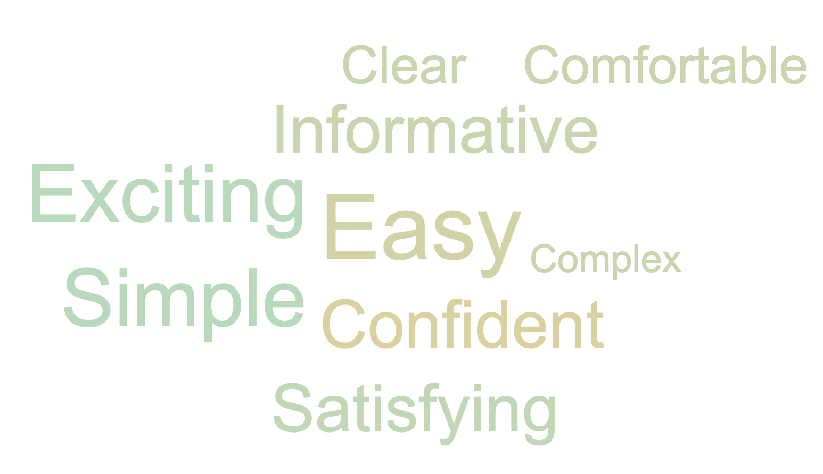
WORD CLOUD

Slide 44
TEAM CONTRIBUTIONS

Slide 45
TEAM CONTRIBUTIONS
NEERAJ ANTURKAR | PRIYA KUMARI
SURVEY & COMPITETOR ANALYSIS | DESIGNS (PAPER PROTOTYPE/WIRE FRAME/MOCKUP)
RED ROUTES | RED ROUTES
TEST PLAN | TEST PLAN
IMPLEMENTATION (GALLERY/DATABASE) | IMPLEMENTATION (EVENTS/LOGIN/REGISTER)
AUTOMATION TESTING | AUTOMATION TESTING
TEST ANALYSIS (EFFICIENCY/EFFECTIVENESS) | TEST ANALYSIS (SATISFACTION)

Slide 46
C O N C L U S I O N

Slide 47
REFERENCES
Unsplash - Non-Commercial Images
Pexels - Non-Commercial Images
Karma Documentation
ArtSpace - Competitor Website
ArtFinder - Competitor Website
MeasuringU - Effectiveness Calculation
UI Gradients - Gradient Preview

Slide 48
T H A N K Y O U

